Slide 1


A Data-Driven Approach to Governance
Financial Health Analysis
Insights from a Municipal Finance Dataset
Prepared for a professional audience of municipal finance professionals, data analysts, and policy-minded users.
Using data to drive transparent and effective municipal management.

Slide 2






Dataset Overview: The Foundation of Our Analysis
We utilized a robust Municipal Financial Health dataset to derive critical insights into local government performance.
Core Source Data
Volume and Integrity
Data sourced from a Municipal Financial Health dataset, focusing on reported annual financial metrics.
Initial analysis covered 959 cleaned entries, ensuring all records were valid and suitable for aggregation.
Key Variables
Calculated Metric: Surplus Ratio
Primary columns analyzed include City, Reporting Year, Total Revenue, Total Expenditure, and calculated Profit/Loss.
A crucial derived metric: Surplus Ratio (Profit/Loss ÷ Revenue) to gauge fiscal efficiency.

Slide 3


Data Quality Assurance and Cleaning Process
To ensure the reliability of our findings, a rigorous data cleaning protocol was followed, addressing inconsistencies and missing values.
Removed Empty Columns
Seventeen peripheral columns deemed irrelevant or sparsely populated were systematically removed to streamline the focus.
Filtered Missing Values
All rows containing incomplete or null values in key fields (Revenue, Expenditure) were excluded from the final analysis.
Numeric Consistency Verified
Data types were verified, and numerical fields were checked for outliers and standardized for calculation accuracy.
Duplicate Records Check
A check for unique City-Year combinations confirmed the absence of duplicate records, maintaining dataset integrity.
Data integrity is paramount for reliable municipal financial modeling and policy development.

Slide 4
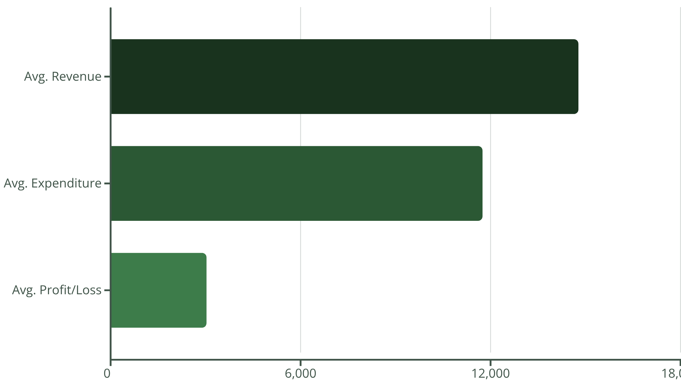
Core Performance Indicators: Key Metrics Snapshot
Analysis across the 959 records reveals strong positive average metrics, demonstrating overall fiscal solvency across the municipalities studied.
14,773.93
11,744.83
3,029.10
20.18%
Average Revenue
Average Expenditure
Average Profit/Surplus
Average Surplus Ratio
Mean total revenue (in generic units) across all recorded municipality-years.
Mean total operational and capital spending (in generic units).
The average fiscal surplus, calculated as Revenue minus Expenditure.
Percentage of revenue remaining after covering all expenditures (Profit ÷ Revenue).

Slide 5





Deeper Fiscal Insights and Efficiency
Moving beyond simple averages, the data suggests systematic trends in municipal financial performance.
Consistent Fiscal Health
The majority of municipalities consistently report a positive fiscal surplus, indicating responsible budget management.
Favorable Growth Dynamics
While expenditure increases, municipal revenue growth tends to outpace it, successfully widening the margin of surplus over time.
Scale and Profitability
Cities with larger total revenues typically demonstrate proportionally higher absolute profit figures, benefiting from economies of scale.
Efficiency Benchmark
The mean Surplus Ratio of approximately 20% serves as a solid benchmark for fiscal efficiency and operational health.

Slide 6
Strategic Recommendations for Sustained Health
To leverage this positive foundation and build long-term resilience, we propose five key areas for policy focus.
Diversify Revenue Streams
1
Explore new non-tax income sources and strengthen existing revenue collection processes to future-proof budgets.
Optimize Expenditure Management
2
Implement performance-based budgeting and zero-based review to ensure every unit of spending maximizes public value.
Monitor Surplus Ratio Continuously
3
Treat the Surplus Ratio as a primary dashboard indicator, establishing target ranges and early warning systems for fluctuations.
Adopt Sustainable Budgeting
4
Shift planning towards multi-year projections and integrate capital improvement plans into operational budgets.
Build Long-Term Resilience
5
Create dedicated reserve funds and strategically plan for macroeconomic shifts and unexpected capital needs.

Slide 7

Summary: Pathway to Continuous Fiscal Strength
The data confirms that the analyzed municipalities exhibit general fiscal soundness and operational efficiency.
Sustained fiscal health requires a commitment to three continuous pillars:
Strong Revenue Strategies: Proactive seeking and management of diverse income sources.
Controlled Expenditure Growth: Disciplined, optimized spending that prioritizes strategic outcomes.
Continuous Indicator Monitoring: Using metrics like the Surplus Ratio for proactive decision-making.
This comprehensive financial health analysis was generated through robust data science techniques using Jupyter Notebook, designed for high transparency and professional discourse on platforms like GitHub and LinkedIn.
The future of municipal finance is data-driven, strategic, and resilient.

